Slide 1
MULTINATIONAL COMPANIES
PREPARED BY P.GEETHIKA
CHOWDARY

Slide 2
TOP MOST MNC’S
IBM
MICROSOFT
NOKIA
PEPSICO
WIPRO
TCS
INFOSYS
CAPGEMINI
COGZENT
HCL
GOOGLE

Slide 3
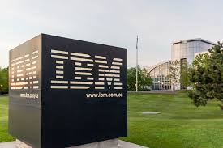
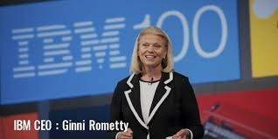
IBM COMPANY
1. IBM:
IBM India Private Limited, a part of IBM has been operating from this country since the year 1992. This global company is known for invention and integration of software, hardware as well as services, which assist forward thinking institutions, enterprises and people, who build a smart planet. With innovative technology and solutions, this company is making a constant progress in India. Present in more than 200 cities, this company is making constant progress in global markets to maintain its leading position.

Slide 4
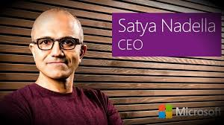
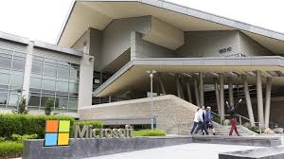
MICROSOFT COMPANY
A subsidiary, named as Microsoft Corporation India Private Limited, of the U.S. (United States) based Microsoft Corporation, one of the software giants has got their headquarters in New Delhi.

Slide 5
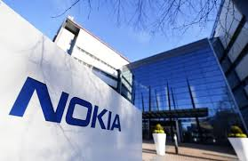
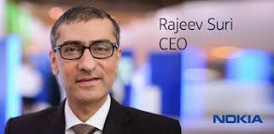
NOKIA COMPANY
Nokia Corporation was started in the year 1865.
Being one of the leading mobile companies in India, their stylish product range includes the following:
i. Normal mobile handsets
ii. Smartphones
ADVERTISEMENTS:
iii. Touch screen phones
iv. Dual sim phones
v. Business phone

Slide 6
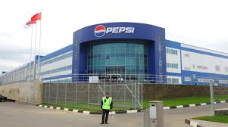
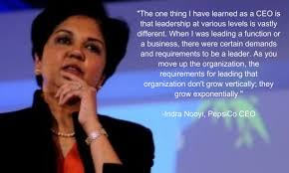
PEPSICO COMPANY
Pepsi Co. Inc. entered the Indian market with the name of PepsiCo India from the year 1989. Within a short time span of 20 years, this company has emerged as one of the fast growing as well as largest beverage and food manufacturer. As per the annual report of the company in the last business year, the net revenue of PepsiCo grew by 33%.
By the year 2020, this food manufacturing company intends to triple their portfolio of enjoyable and wholesome offerings. The expansion of their Good-For-You portfolio is believed to be assisting the company in attaining the competitive advantage of the growing packaged nutrition market in the world, which is presently valued at $ 500 billion.

Slide 7
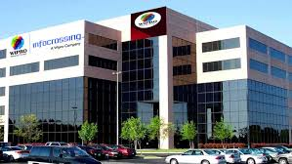
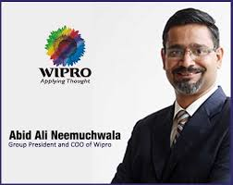
WIPRO COMPANY
The company was incorporated on 29 December 1945 in Amalner, Maharashtra by Mohamed Premji as "Western India Palm Refined Oil Limited", later abbreviated to "Wipro". It was initially set up as a manufacturer of vegetable and refined oils in Amalner, Maharashtra, British India, under the trade names of Kisan, Sunflower, and Camel.^{[5][6][7]}
In 1966, after Mohamed Premji's death, his son Azim Premji returned from Stanford University and took over Wipro as its chairman at the age of 21.^{[8][9]}

Slide 8
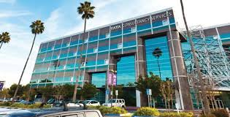
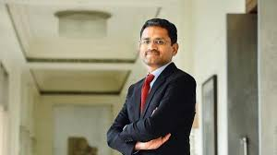
TCS COMPANY
Tata Consultancy Services Limited (TCS) is an Indian multinational information technology (IT) service and consulting company headquartered in Mumbai, Maharashtra, India.^{[3][4]} It is a subsidiary of Tata Group and operates in 149 locations across 46 countries.^{[5]}
TCS is the second largest Indian company by market capitalization.^{[6][7]} Tata consulting services is now placed among the most valuable IT services brands worldwide.^{[8]} In 2015, TCS was ranked 64th overall in the Forbes World's Most Innovative Companies ranking, making it both the highest-ranked IT services company and the top Indian company.^{[9]} It is the world's largest IT services provider.^{[10]} As of 2018, it is ranked eleventh on the Fortune India 500 list.^{[11]} In April 2018, TCS became the first Indian IT company to reach $100 billion market capitalization,^{[12]} and second Indian company ever (after Reliance Industries achieved it in 2007)^{[13]} after its market capitalization stood at ₹6,79,332.81 crore ($102.6 billion) on the Bombay Stock Exchange.^{[14][15][16]}

Slide 9
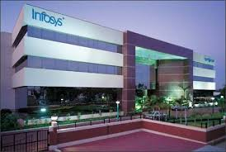
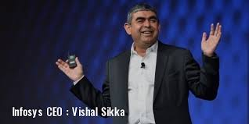
INFOSYS COMPANY
Infosys was established by seven engineers in Pune, Maharashtra, India with an initial capital of $250 in 1981.^{[7]} It was registered as Infosys Consultants Private Limited on 2 July 1981.^{[8]} In 1983, it relocated its office to Bangalore, Karnataka, India.
Name change: The company changed its name to Infosys Technologies Private Limited in April 1992 and to Infosys Technologies Limited when it became a public limited company in June 1992. It was later renamed to Infosys Limited in June 2011.^{[9}

